Slide 1

KSCT Fall Meeting
Theoretical Separation Feasibility of Zeolites for Gas Sweetening Process
Sep 9th 2021
Seongbin Ga
Pusan National University

Slide 2


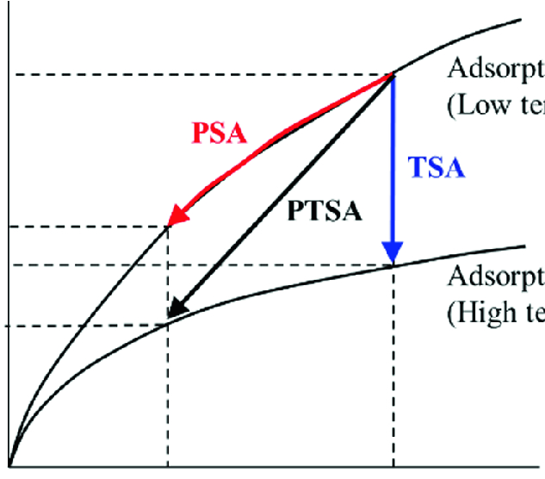
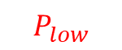
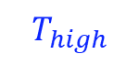
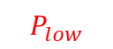
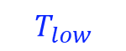
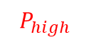
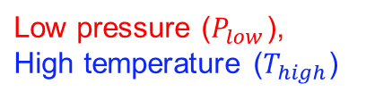
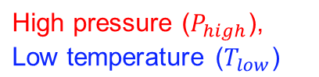
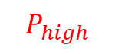
How Adsorption Processes Work
Adsorption phenomena on adsorbent surface
Raffinate product
Adsorption at condition 1:
High pressure ($P_{high}$), Low temperature ($T_{low}$)
Increased pressure
Adsorbent particles
Desorption at condition 2:
Low pressure ($P_{low}$), High temperature ($T_{high}$)
Adsorption isotherm curve (key data)
Decrease pressure
$$T_{low}$$
Pressures swing adsorption (PSA) process
Temperature swing adsorption (TSA) process
$$P_{high}$$
$$P_{low}$$
Uptake (mol/kg)
Compressed feed
Low pressure exhausting
$$T_{high}$$
$$P_{low}$$
$$P_{high}$$
Pressure (bar)

Slide 3
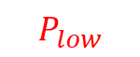

Cyclic Operation of Adsorption Process
Adsorption isotherm curve (key data)
Uptake (mol/kg)
$$P_{low}$$
$$P_{high}$$
Pressure (bar)

Slide 4
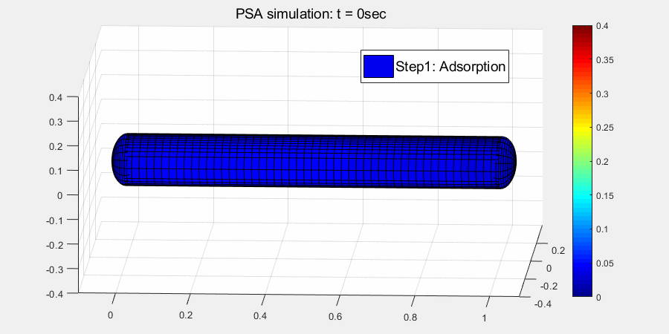
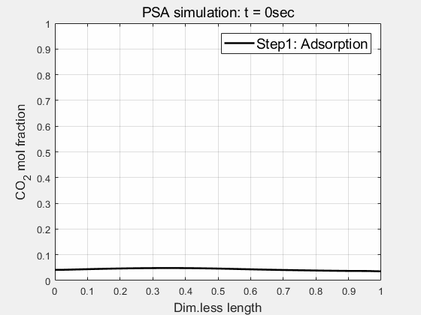
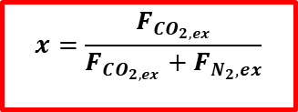
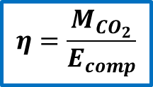
Cyclic Operation of Adsorption Process
Cycle configuration
Simulation results
Process-level performance
time (sec)
e.g. CO₂/N₂ separation (gas phase concentration)
Step 1:
adsorption
Efficiency (CO₂ ton/ GJ)
$$η=\frac{M_{CO_{2}}}{E_{comp}}$$
Step 2:
pressure equalization (P↓)
CO₂ purity (mol/mol)
$$x=\frac{F_{CO_{2,ex}}}{F_{CO_{2,ex}}+F_{N_{2},ex}}$$
Step 3:
blowdown
Step 4:
evacuation
Step 5:
pressure equalization (P↑)
Step 6:
re-pressurization

Slide 5
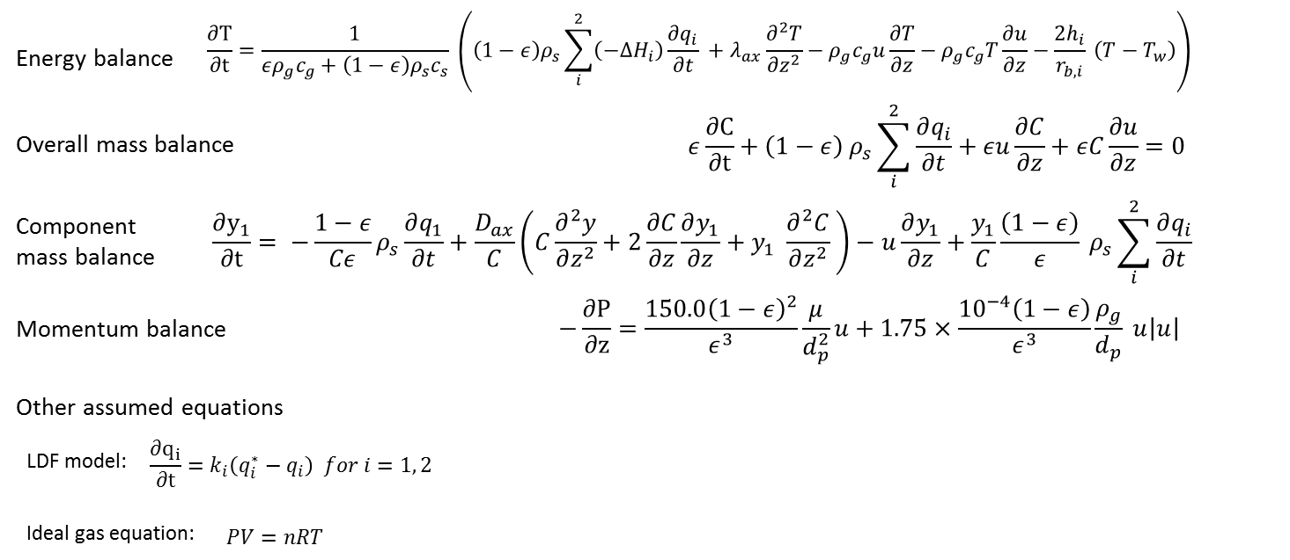
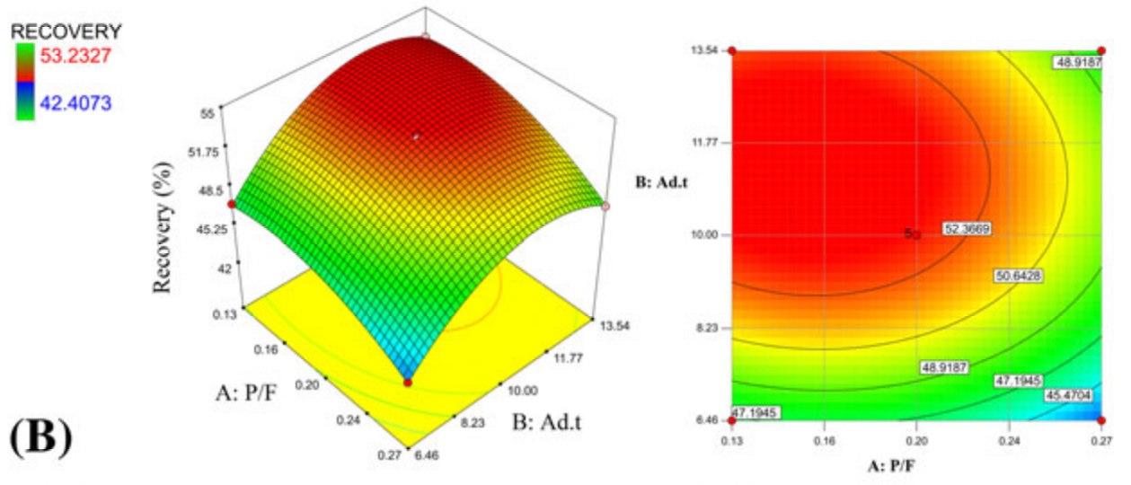
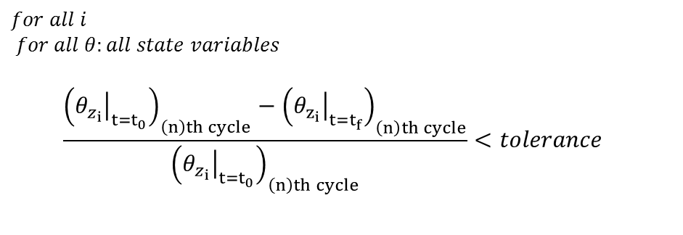

Problem 1: CPU time
Suppose we have many adsorbents to evaluate.
Mass, momentum, and energy balance equations
For each adsorbent, we need
1) Dynamic simulations (min-level)
2) Cyclic steady state search (hr-level)
3) Design & operation optimization (day-level)
Operation optimization example
Adsorbent 1 → optimal operation set 1
$$≠$$
Adsorbent 2 → optimal operation set 2
Cyclic steady state (CSS) conditions
CSS swing
…
…
0
uptake
Ref) Saberimoghaddam, & Khebri, J. Chemometrics, 2016

Slide 6
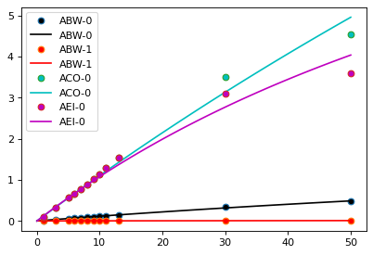

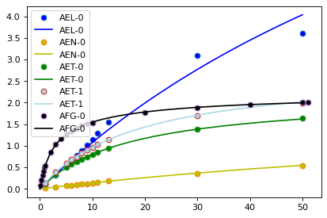
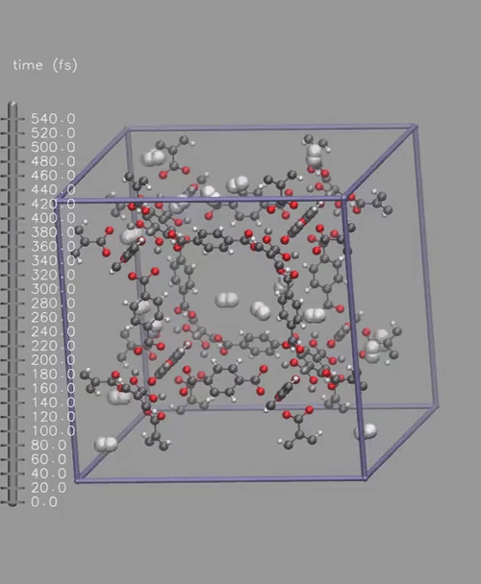
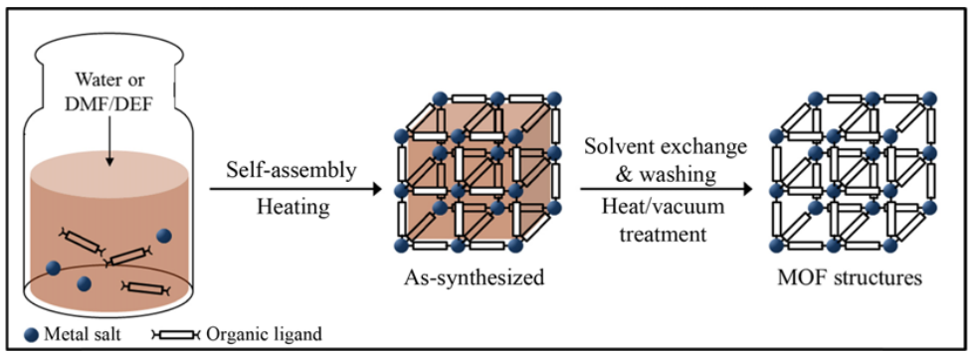
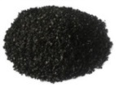
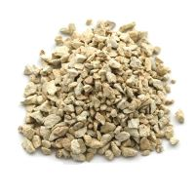

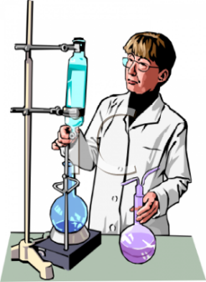
Problem 2: Limited information
For the dynamic simulation for the PSA process, a variety of adsorbent properties are essential:
Adsorption isotherm curves = The first property they can obtain.
Adsorption isotherm data, heat of adsorption, mass/heat transfer coefficients, heat capacity, density ….
Adsorption isotherm data
Most of them are rarely available,
Uptake (mol/kg)
newly discovered or
especially when they are:
newly developed or
newly synthesized
Pressure (bar)
Molecular simulations
Synthesis of adsorbents
Various materials
Uptake (mol/kg)
…
Activated carbon
Zeolite
MOF
etc.
Pressure (bar)
…
Ref) Lee, Kim, and Ahn, KJChE, 2013

Slide 7
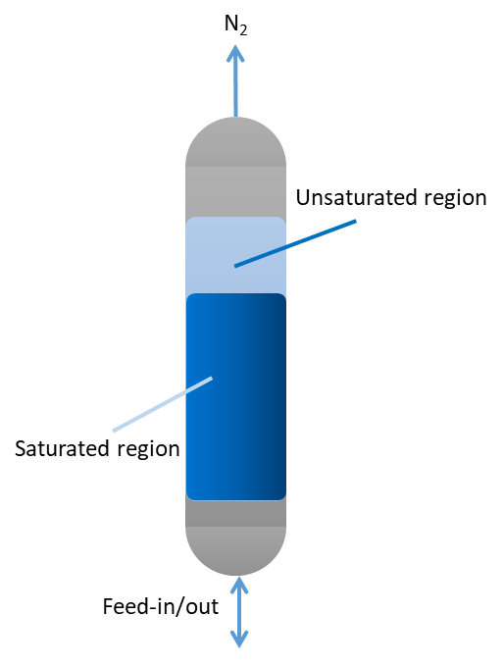
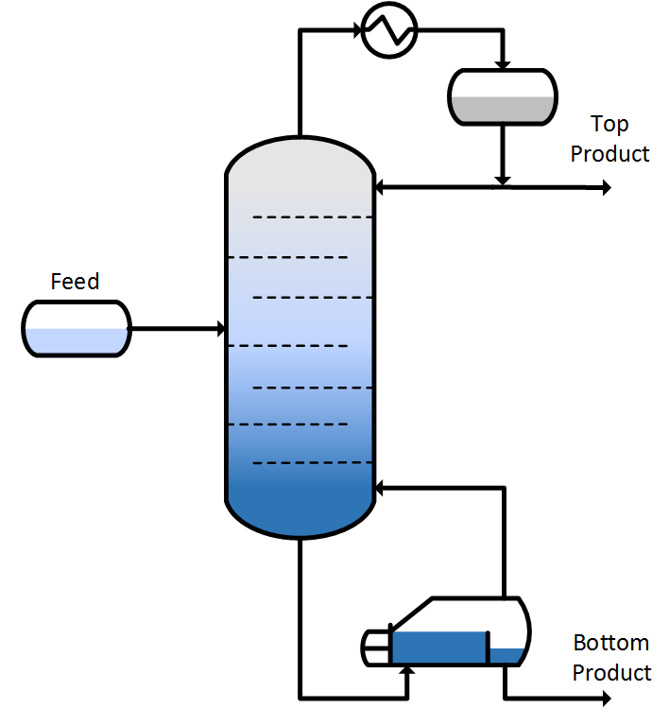
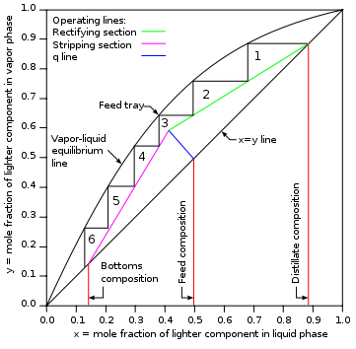
Idea: Ideal PSA Process
Inspired by McCabe Thiele method or Fenske equation
[Shortcut method: ideal PSA process]
For distillation column
For pressure swing adsorption (PSA) column
Equilibrium info.
Required process (operation or design)
Isotherm info. (Usually measured first)
Required process (operation or design)
Feed conditions
Feed conditions
Target purity
Target purity
?
(Available for material developers)

Slide 8
Idea: Ideal PSA Process
[Shortcut method: ideal PSA process]
Derivation of the method (formula) starts from a set of assumptions (idealization):
For pressure swing adsorption (PSA) column
Isotherm info. (Usually measured first)
Two gas components
No dispersion: clear saturated region boundary
Two periods: saturation & desaturation
Full capacity of the adsorbents
Always in solid/gas equilibrium
No effect of void volume
Required process (operation or design)
Feed conditions
Target purity
?
(Available for material developers)
Saturation period
Desaturation period
mol. frac.
Saturated region
Unsaturated region
Axial (m)
20/32

Slide 9
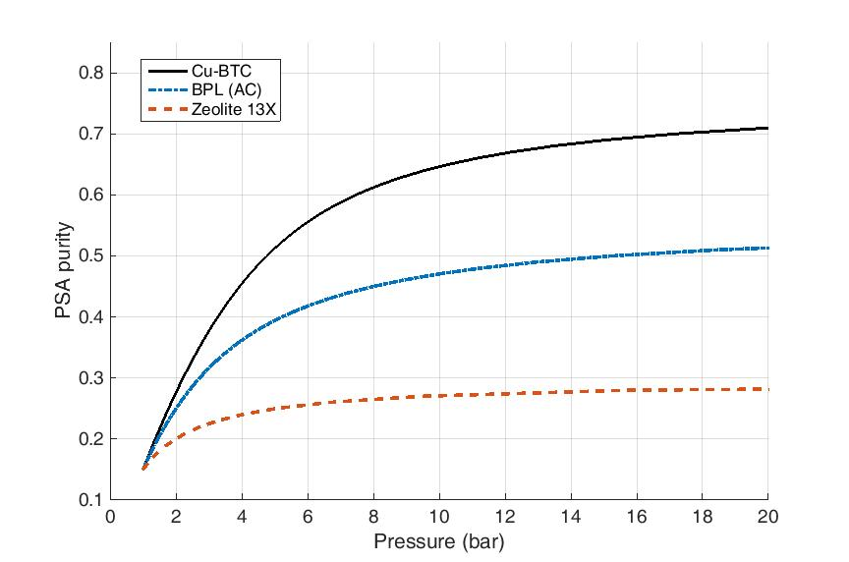
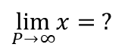
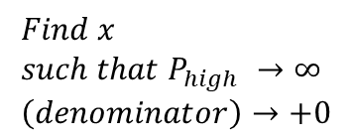
Formula: Ideal PSA Process
New shortcut evaluation method
(Purity)—(operating pressure) graph
$\lim_{P→∞}x= ?$
Efficiency
Purity
[Converges to a certain value]
$$Find x \\ such that P_{high} →∞ \\ \left(denominator\right)→+0$$
Asymptotically approach
Advantages of them:
Upper limit of purity (purity cannot exceed this)
Reflective of the application to the PSA process
Easy to use and requiring only isotherm parameters
Small computational cost (compared to PSA simulation time: ~2000 sec for testing a single condition)
Proposed in
S. Ga et al., Comput. Chem. Eng., 2017

Slide 10
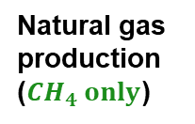
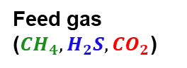
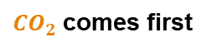
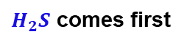
Multi-component Case: CH₄/H₂S/CO₂
Natural gas sweetening process (feed gas contains CH₄/H₂S/CO₂):
Different adsorbents can be classified into three cases.
Adsorbent A
Adsorbent B (H₂S leading case)
Adsorbent C (CO₂ leading case)
(CH₄ leading case)
Natural gas production ($CH_{4} only$)
$H_{2}S$ comes first
$CO_{2}$comes first
CH₄
CO₂
Desirable cases
H₂S
Feed gas ($CH_{4}, H_{2}S, CO_{2}$)
Feed gas ($CH_{4}, H_{2}S, CO_{2}$)
Feed gas ($CH_{4}, H_{2}S, CO_{2}$)

Slide 11
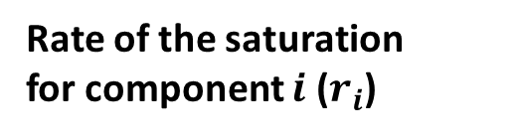
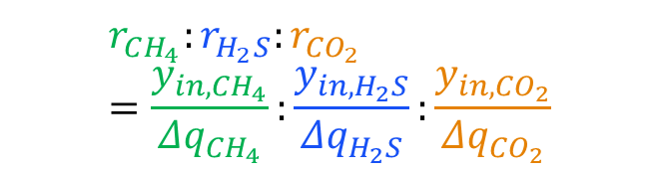

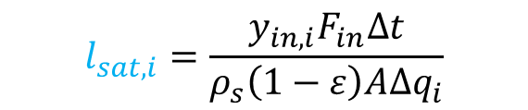

Expansion Set of The Ideal PSA Method
Leading component concept
During the adsorption step, the saturated region is propagated by the feed gas.
The rate of saturation differs for each gas component.
From the ideal PSA concept, we can calculate the rate of saturation as:
Saturated
Unsaturated
Feed
$$l_{sat,i}$$
Rate of the saturation for component $i$ ($r_{i}$)
From the mass balance,
Therefore,
$$y_{in,i}F_{in}Δt=ρ_{s}\left(1−ε\right)A l_{sat,i}Δq_{i}$$
$$r_{CH_{4}}:r_{H_{2}S}:r_{{CO}_{2}} \\ =\frac{y_{in,CH_{4}}}{Δq_{CH_{4}}}:\frac{y_{in,H_{2}S}}{Δq_{H_{2}S}}:\frac{y_{in,CO_{2}}}{Δq_{CO_{2}}}$$
$$r_{i}=\frac{l_{sat,i}}{Δt}$$
$$l_{sat,i}=\frac{y_{in,i}F_{in}Δt}{ρ_{s}\left(1−ε\right)AΔq_{i}}$$
[Definition]
[Length of saturation region]
[Ratio of the rate] = [Ratio of length]

Slide 12

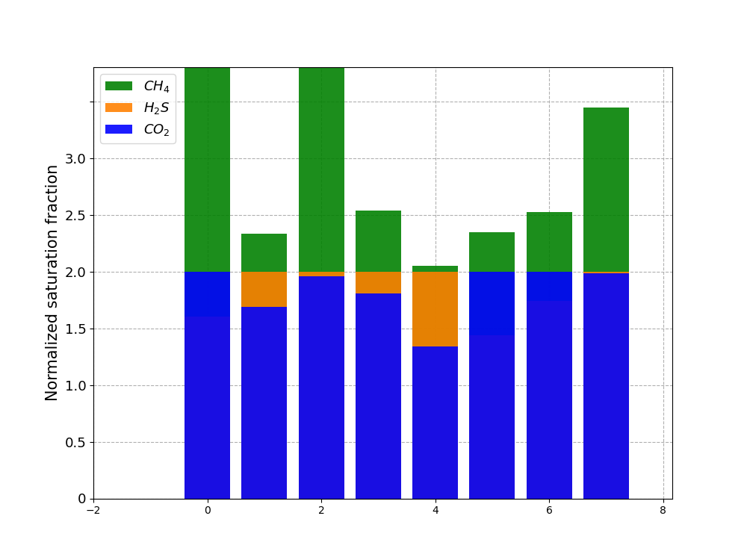
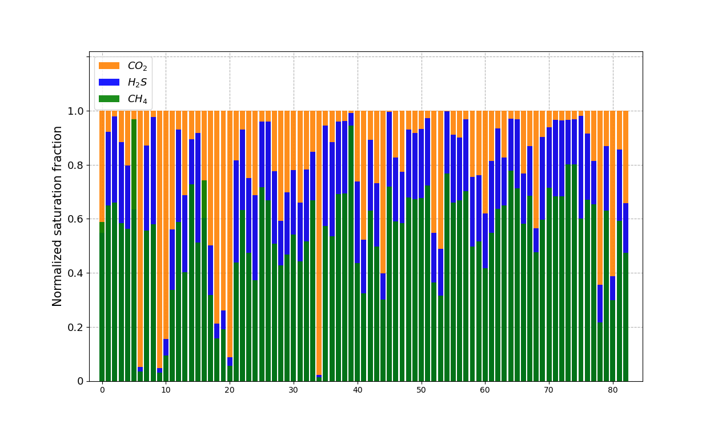
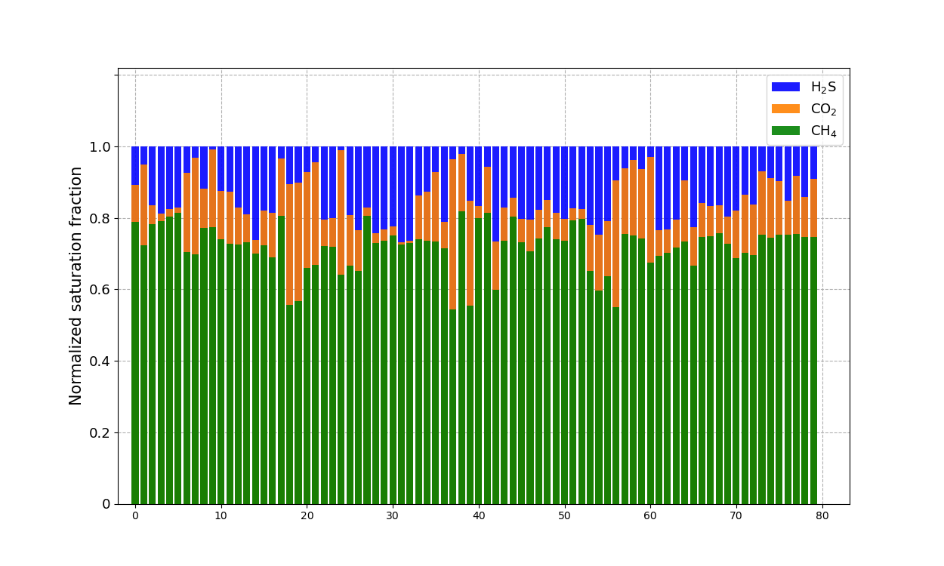
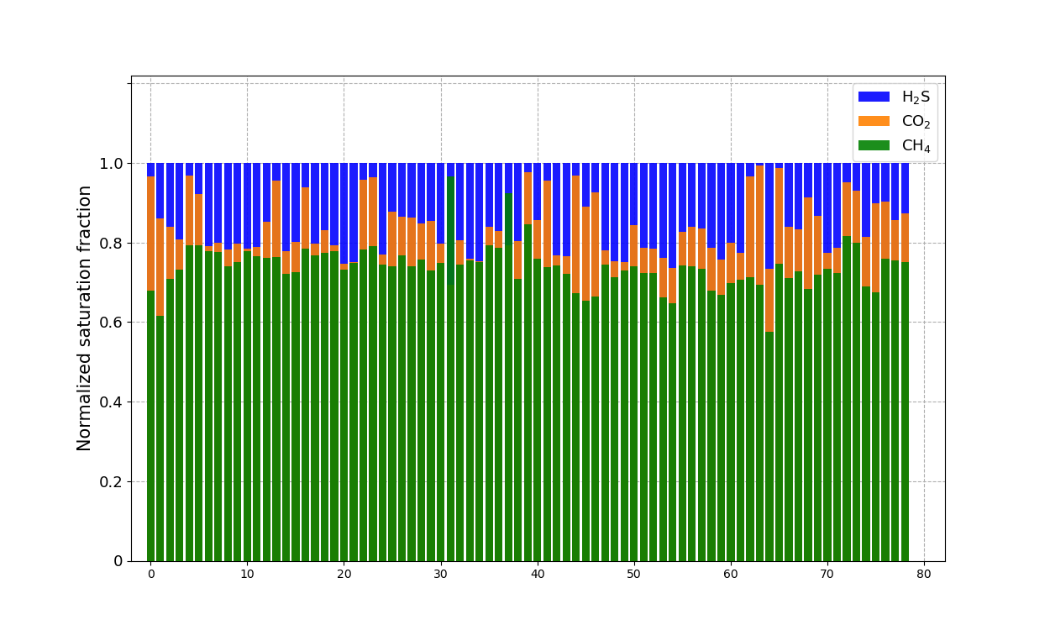
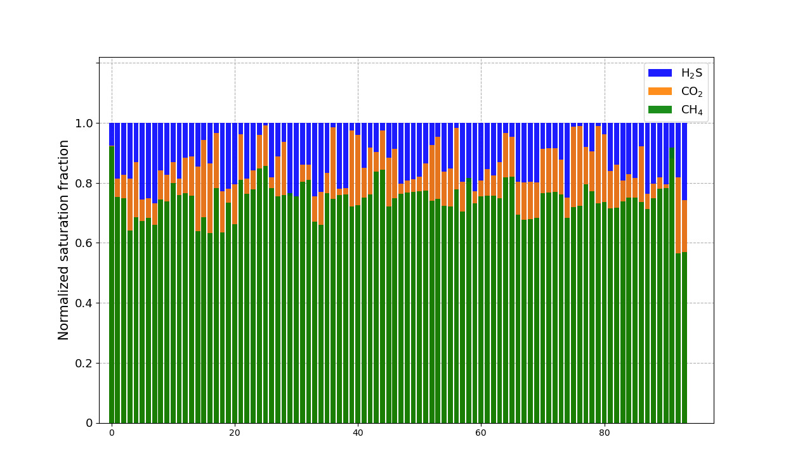
Application to Zeolite Database
International Zeolite Association (IZA) database
Database providing structural information of over 300 zeolites
Data in the crystallographic information framework (*.cif) file
Online available database
Ideal PSA simulation Results: Classifying zeolites of IZA database
(1) CH₄ leading case (8 zeolites)
(2) H₂S leading case (255 zeolites)
(3) CO₂ leading case (83 zeolites)

Slide 13
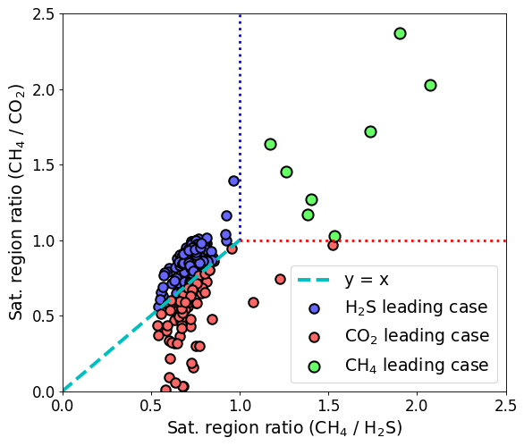
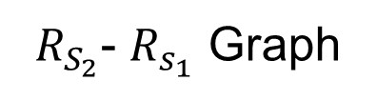
Visualization for Classification
$R_{S_{2}}$- $R_{s_{1}}$ Graph
Different Saturation regions
AEI-0
APC-1
CDO-1
JBW-0
MON-0
RRO-0
VSV-0
WEI-0
Feasible candidates
CH₄
H₂S
CO₂
Saturation region ratio
R_{s1} =
CH₄
> 1
H₂S
R_{s2} =
CH₄
> 1
CO₂

Slide 14
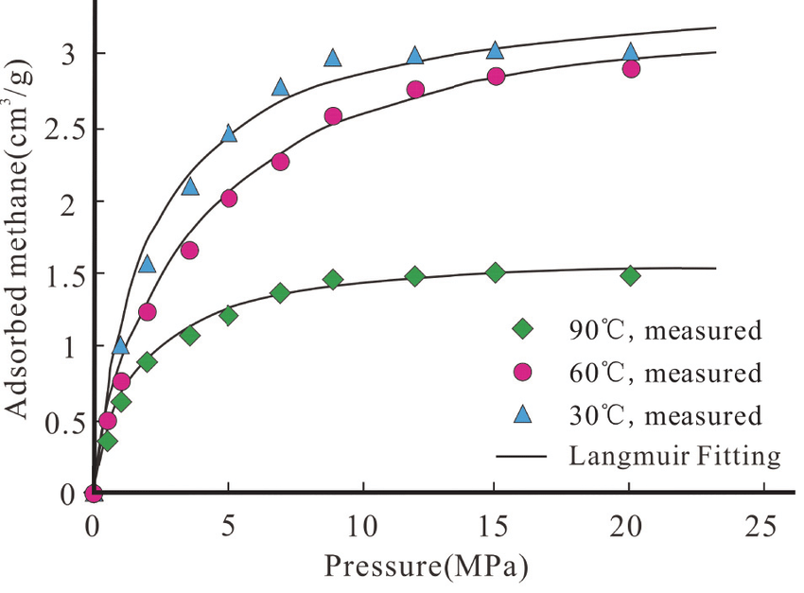
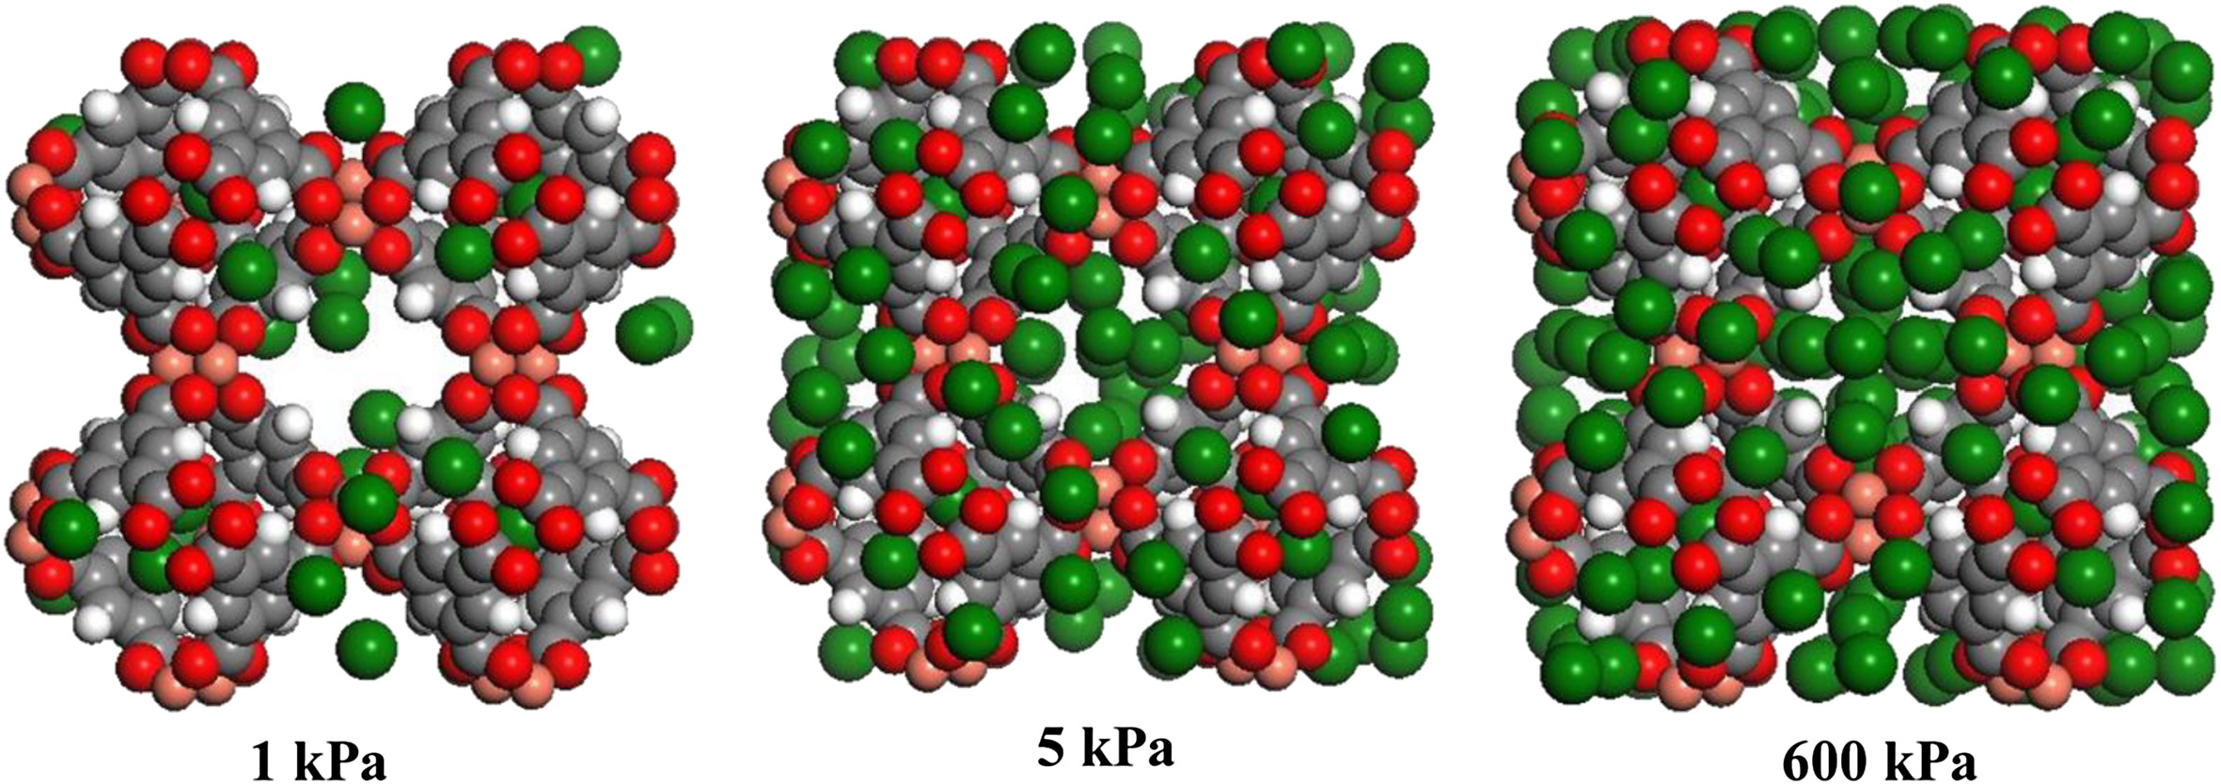

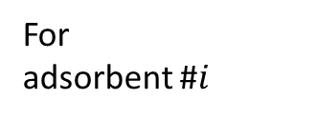
Advantages of This Method
ex) design/operation
Conventional method
Feasible
Condition 1
Process simulations & optimization
Infeasible
Isotherm fitting
Molecular simulations
Feasible
Condition 2
Infeasible
…
Several CPU weeks (to test a single adsorbent)
For adsorbent #$i$
Feasible
Condition N
New feasibility test method
Infeasible
Molecular simulations
Saturation region ratio
Infeasible
Feasible
Several CPU hours (for 346 adsorbents)

Slide 15
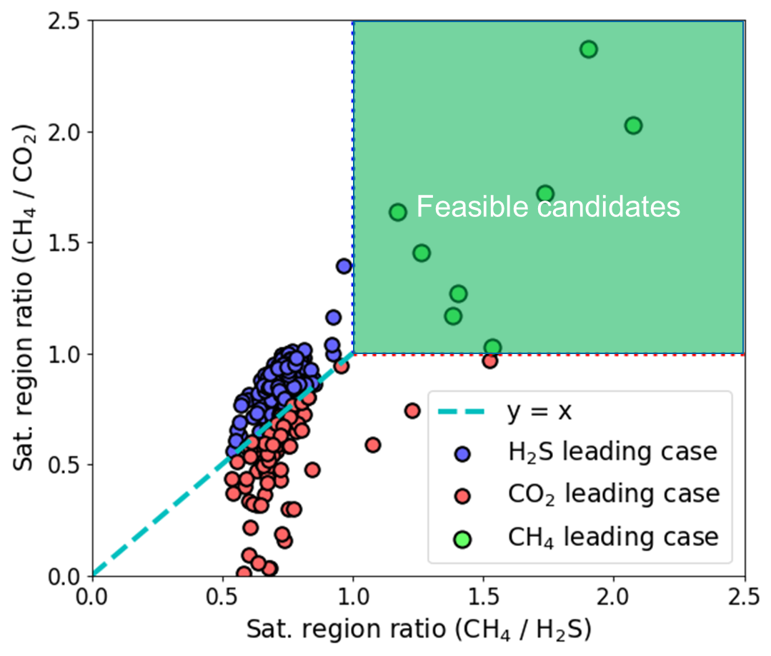
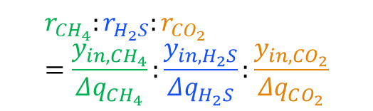
Conclusion
Saturation period
Desaturation period
Shortcut evaluation method: Ideal PSA process
Extension to multicomponent case: The shortcut method with multiple gas components
Feasibility test method: Feasibility for the separation process
Using IZA database, the separation feasibility was tested for 346 zeolites, and 8 zeolites were found to be feasible.
mol. frac.
Saturated region
Unsaturated region
Axial (m)
$$r_{CH_{4}}:r_{H_{2}S}:r_{{CO}_{2}} \\ =\frac{y_{in,CH_{4}}}{Δq_{CH_{4}}}:\frac{y_{in,H_{2}S}}{Δq_{H_{2}S}}:\frac{y_{in,CO_{2}}}{Δq_{CO_{2}}}$$

Slide 16


Seongbin Ga School of Chemical Engineering Pusan National University (PNU) Republic of Korea
Email: sga00@pusan.ac.kr Web CV: http://sebyga.github.io/resume

Slide 17
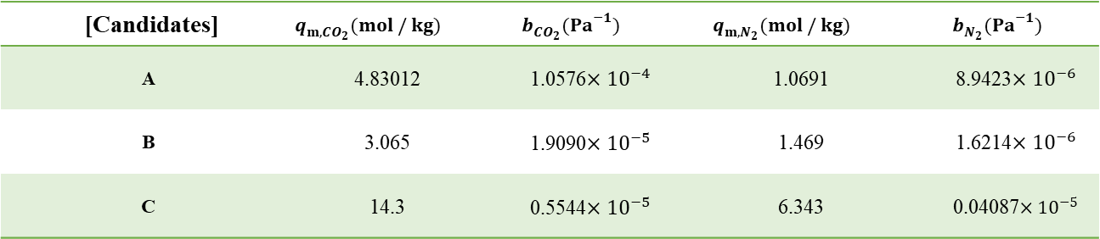

Validation: Ideal PSA Process
In
S. Ga et al., Comput. Chem. Eng., 2017
I theoretically derived the method, and roughly validated by comparing with the rigorous (dynamic) simulations.
Comparison of the sorbents (if target purity = 0.5)
PSA dynamic simulation (non-ideal) | Selectivity
0.1992 | 100~300
0.2601 | 20~26
0.333 | 7~25
cf) Working capacity (1~15bar)
A: 2.2mol/kg
B: 0.95mol/kg
C: 8.1mol/kg
Zeolite 13X
>
>
>
BPL (AC)
>
>
>
Cu-BTC
>

Slide 18


Validation: Ideal PSA Process
Realff group in Georgia Tech has validated with many adsorbents.
Shortcut method: ideal PSA process
Rigorous simulations: dynamic model
You, Sen et al., Applied Nano Mat. 2020

Slide 19
Application of the Method

Slide 20



Application 1: CO₂ Capture
Use of molecular simulation (Co-work with Jihan Kim’s group in KAIST)
Sorbent structure information
Property parameters
Shortcut evaluation method
CoRE MOF Database: Web available library of MOF structures
isotherm parameter library database
Ranking of the adsorbents for given…
Isotherm information
…
Feed conditions
Target purity
Y. Chung, et al., Science Advances, 2016

Slide 21




Application 1: CO₂ Capture
Graphical user interface (GUI) for sorbent evaluation
Parameter library from molecular simulations
In a idealized pressure swing adsorption (PSA) process for CO₂
Thousands of candidates: - CoRE MOF (about MOFs) - IZA (about zeolites)
Operating conditions:
Packed sorbents
Feed conditions:
Product out
Feed in
- $x_{targ}$ - $P_{vac}$
- $P_{prod}$
- $T_{feed}$
- $y_{feed}$ -$P_{feed}$

Slide 22

Application 1: CO₂ Capture
Graphical user interface (GUI) for sorbent evaluation
Input GUI for sorbent ranking
Example ranking result
Candidates that cannot achieve the target purity and their upper bound list ($x_{upp}$)
Ranking of adsorbents with quantified performance: efficiency (CO₂ ton/ GJ)

Slide 23

Application 1: CO₂ Capture
Graphical user interface (GUI) for sorbent evaluation
Available in File Exchange webpage (MathWorks):
https://kr.mathworks.com/matlabcentral/fileexchange/71661-general-adsorbent-library-and-evaluation-gale
Proposed in
S. Ga et al., Comput. Chem. Eng., 2020

Slide 24






Application 2: MOFs for Ethane/ethylene Separation
Dr. Yongchul Chung
Dr. Seongbin Ga
Dr. Chang Seop Hong
Molecular simulations of 6,830 metal organic frameworks (MOFs) from CoRE MOF database
Shortcut method for VSA process
Best MOFs
Synthesize of top 3 MOFs, measurement, and durability test
Ethane/ethylene Isotherms
Compare with recently reported MOFs
Durable MOFs measured data
Reported in
Kang et al., Adv. Sci., 2021

Slide 25



Application 3: MOFs for SF₆/N₂ Separation
[Use of CoRE MOF database again for SF₆/N₂ separation]
Based on the molecular simulation results (isotherm curves of 2,890 MOFs),
we found any of MOFs cannot achieve 90% SF₆ with a PSA process.
Product SF₆ purity for different adsorbents
Then, we need to use cascade PSA with two trains:
Reported in
Cha et al., Chem. Eng. J., 2021

Slide 26

Summary
Saturation period
Desaturation period
Shortcut evaluation method
Shortcut evaluation method has been suggested by assuming an ideal PSA process.
The method provides quick evaluation with limited information.
CO2 mol. frac.
Saturated region
Unsaturated region
Applications of the shortcut evaluation method
Axial (m)
Adsorbents for CO2 capture can be evaluated, which is also available in a GUI form.
MOF screening work found Ni(IN)₂ for C2 separation, whose durability and separation performance have been tested.
Through the shortcut method, we found SF₆ separation requires cascade PSA process with at least two PSA trains.

Slide 27
Table of Contents
1. Shortcut Adsorbent Evaluation Method
1. How adsorption processes work
2. Problems of the existing methods
3. Breakthrough: shortcut method (ideal PSA process)
4. Validation of the process
2. Applications to Different Areas
1. For CO₂ capture and graphical user interface (GUI)
2. Ethane/ethylene (C₂) separation
3. SF₆ capture

